Slide 1
ESP32C Flashing, Provisioning and Line Test with C3 Flasher

Slide 2
Pre-Requisites
C3 Flasher
ESP32C Hardware
Flashing and Provisioning Tool – Windows Software
Line Testing using AC Simulator
AC Simulator for Commission then RAC
Type B USB Cable
FTDI Chip
Mini USB A Cable
Jumper Cables

Slide 3
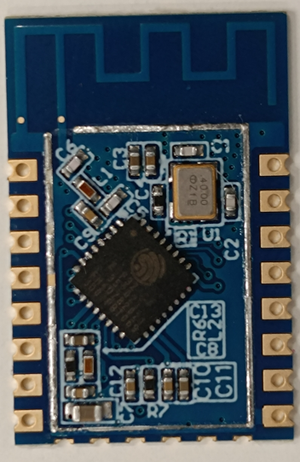
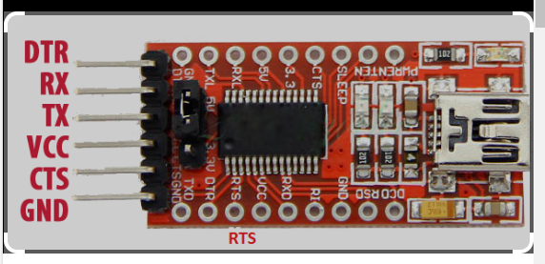
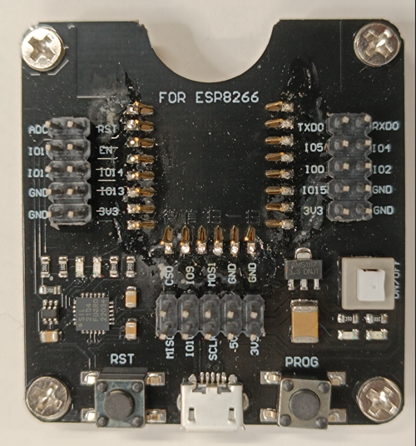
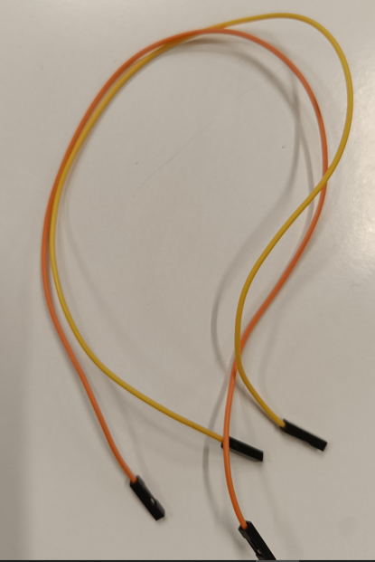
C3 Flasher
Pre-Requisites
ESP32C
Jumper Cable
FTDI

Slide 4

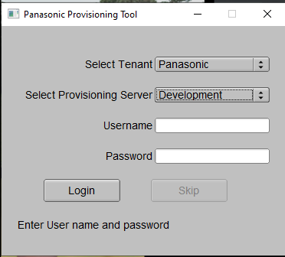
Flashing and Provisioning Tool – Windows Software
Please install OpenSSL and Set Environmental Path as per attached instructions file
Open Tool from given folder – Shown as per below
Select Tenant and Environment
Enter below username and password
Username -
Password :-

Slide 5
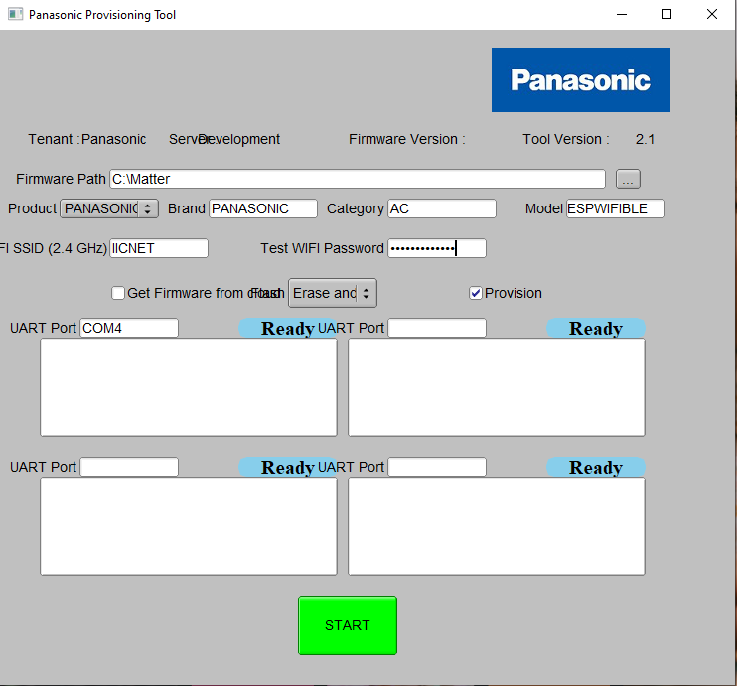
Flashing and Provisioning Tool – Windows Software
Copy firmware in folder as per given example without space
C:\Matter
Select Product AC
Input SSID and Password [2.4 GHz]
Input UART Port [Get it from Device Manager]

Slide 6
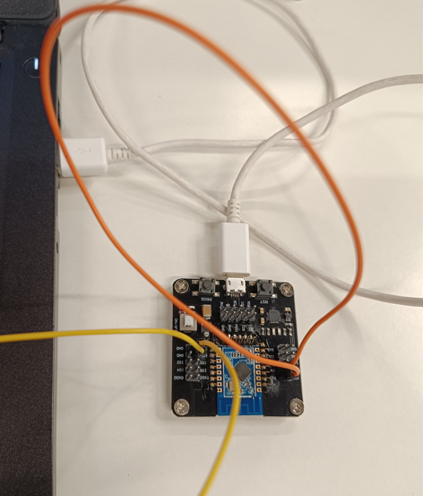
Flashing and Provisioning Tool – Windows Software
Connect Jumper wires on Flasher as per show below picture
Connection 1 : RST – EN
Connection 2 : 3V3 – IO15
Place ESP32C Module on C3 Flasher as per Shown in picture
Connect C3 Flasher with USB Port on laptop
Search Port in Device Manager and Enter
Same COM port in Panasonic Provisioning Tool

Slide 7
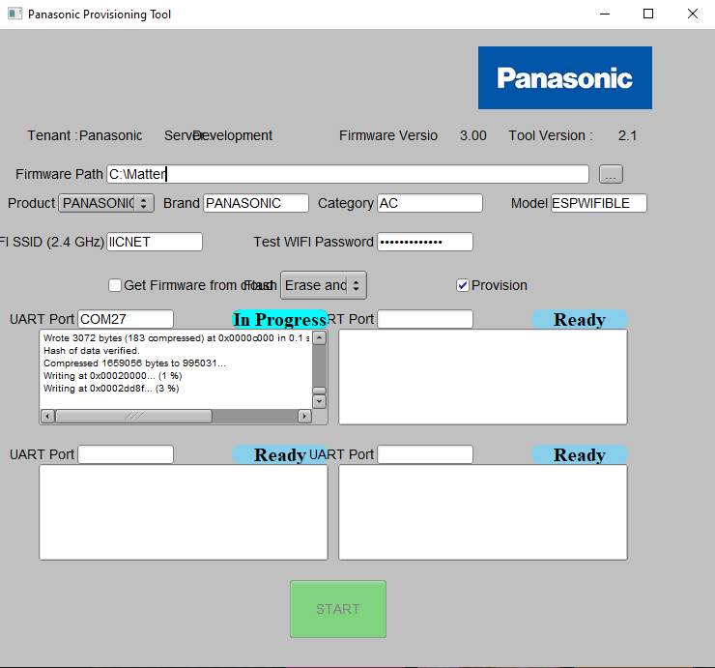
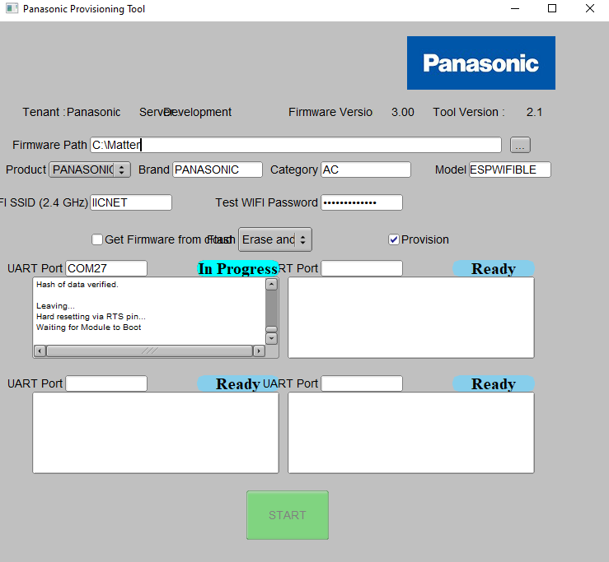
Flashing and Provisioning Tool – Windows Software
Flashing progress

Slide 8
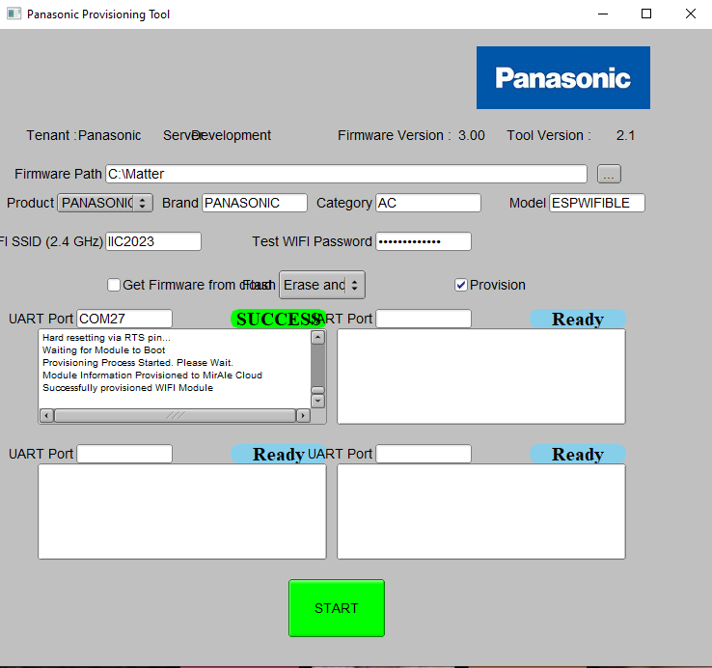
Flashing and Provisioning Tool – Windows Software
Provision Pass

Slide 9
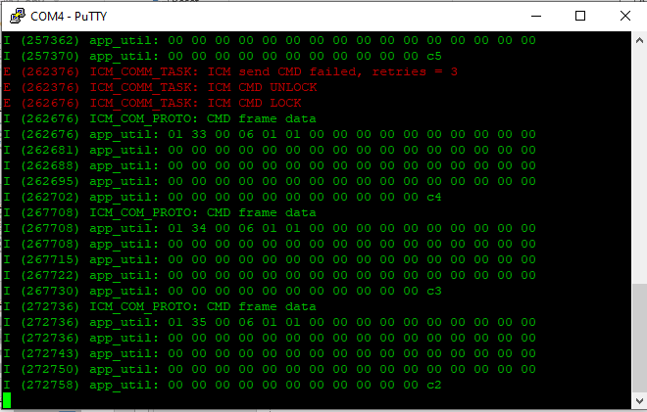
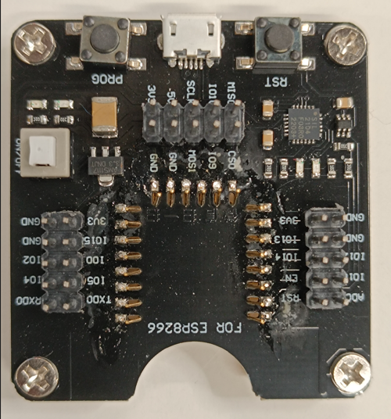
Line Test – Using AC Simulator
Precondition – User must have Python installed in System
Open AC Simulator Tool and Input COM Port e.g. COM27 [Shown in Device Manager]
Install Putty or Hercules to capture UART Logs for progress on line Test
For Capture logs connect GND pin from C3 Flasher
To GND pin of FTDI and IO2 pin from C3 Flasher to RX pin of FTDI

Slide 10
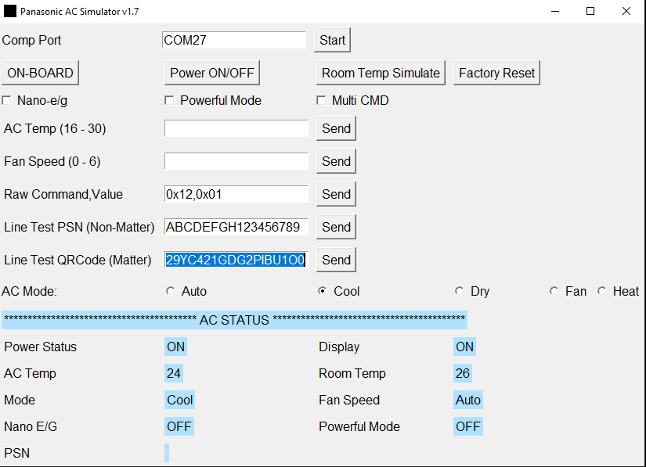
Line Test – Using AC Simulator
Open AC Simulator Tool and Input COM Port e.g. COM27 [Shown in Device Manager}
  Update QR code string field by given QR code e.g. MT:A3L90Q1Y00XZ.52AE4P0OUYH0O9ZR1S2QC29YC421GDG2PIBU1O0
Click on 'Send' button next to QR code.

Slide 11
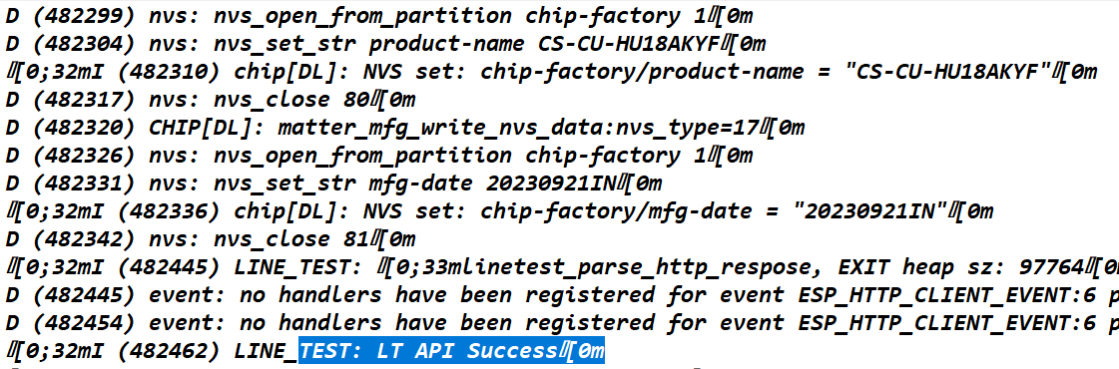
Line Test – Using AC Simulator
Check Putty Log with logs prints . If it shows then Line Test Pass

